Slide 1

On the Impact of the Clustering Strength of Connected and Autonomous Vehicles in Mixed Traffic
Session: Transport Planning and Operations (1)
Peilin Zhao, Yiik Diew Wong, Feng Zhu
School of Civil and Environmental Engineering
Nanyang Technological University
09 July 2024 - APTE
Notes:
Good morning, everyone. I am pleased to share our research on the impact of the clustering strength of Connected and Autonomous Vehicles in mixed traffic.

Slide 2

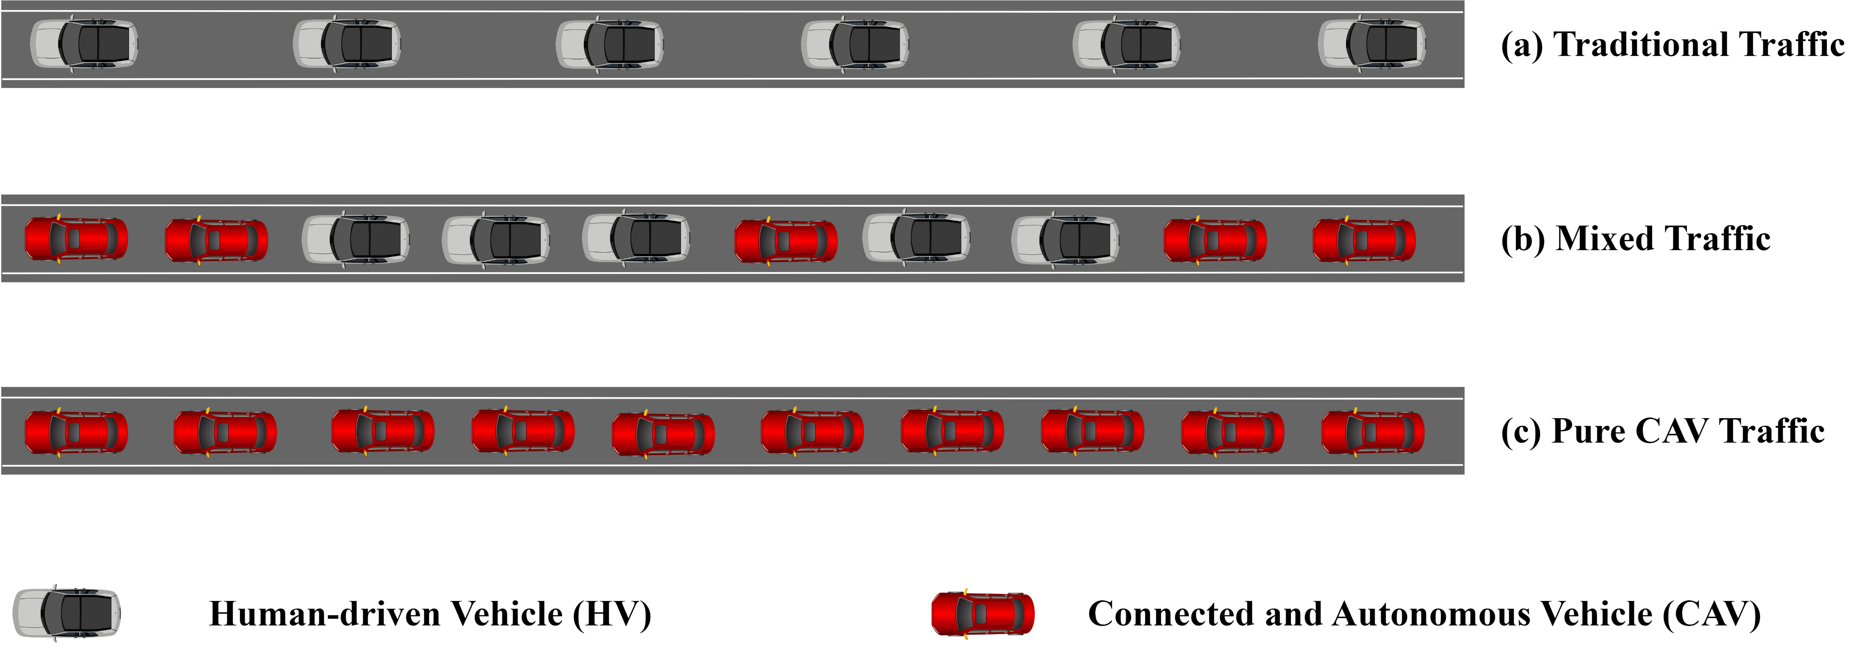
Introduction
Preliminary
API
Flow Estimation
Conclusion
What is the Mixed Traffic?
Notes:
Nowadays, vehicles on the road are commonly driven by human drivers. However, with the development of autonomous driving technology, more and more connected and autonomous vehicles will exist. Then, the traffic will have a mix of Human-driven Vehicle (HV) and Connected and Autonomous Vehicle (CAV), creating what we called the mixed traffic.

Slide 3
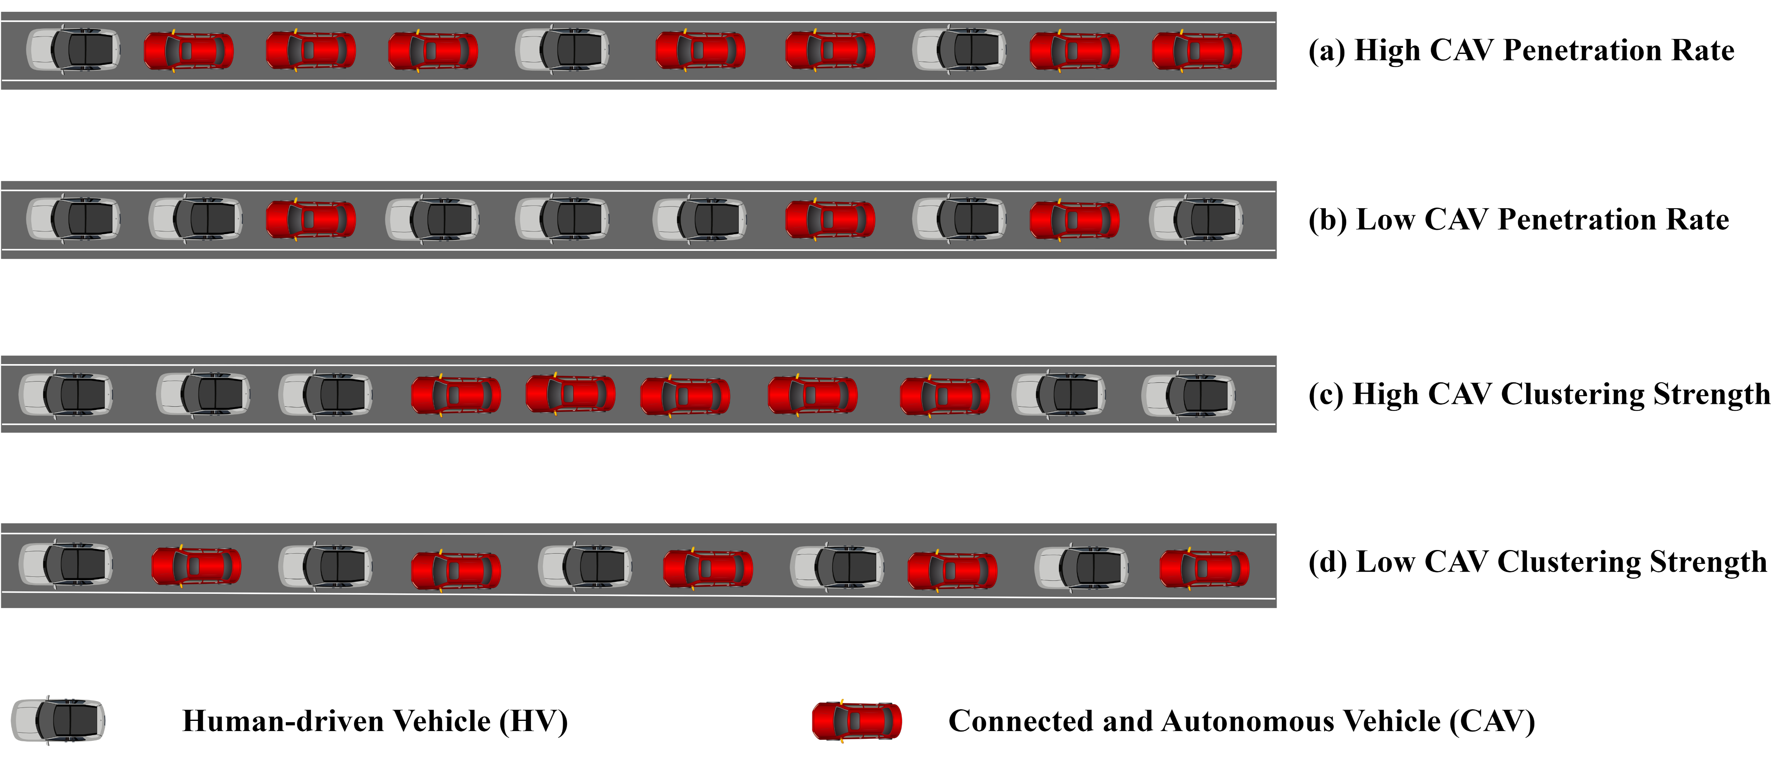
Introduction
Preliminary
API
Flow Estimation
Conclusion
How can we characterize the Mixed Traffic?
Notes:
Unlike traditional traffic, mixed traffic includes two types of vehicles: CAVs and HVs. This mix brings up an interesting question: how do we characterize mixed traffic? One key aspect is the proportion of CAVs among all vehicles, known as the CAV penetration rate. For instance, scenario A has a higher CAV penetration rate than scenario B. Another important characteristic is clustering strength. High clustering means all CAVs are grouped together, while low clustering means they are spread out. For example, scenario C has a higher level of clustering than scenario D.

Slide 4
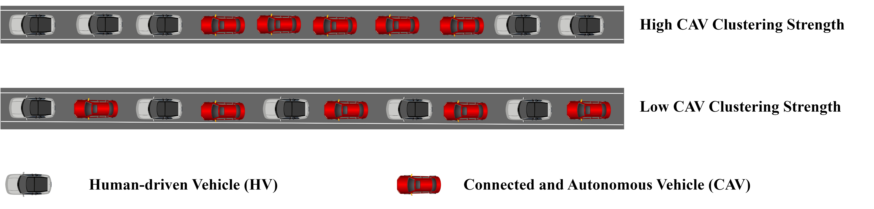
Introduction
Preliminary
API
Flow Estimation
Conclusion
CAV Clustering Strength
CAV clustering enables vehicles communication and platoon formation.
Moving as a CAV platoon can increase the traffic efficiency.
Notes:
So why do concern the CAV clustering strength? It is because that if CAVs gather together, there will be chances for them to employ inter-vehicle communication and hence form the CAV platoon. And moving as CAV Platoons is regarded as way to increase traffic efficiency.

Slide 5
Introduction
Preliminary
API
Flow Estimation
Conclusion
Significance of Mixed Traffic Characteristics
Mixed Traffic Characteristics
Traditional Traffic Characteristics
CAV Penetration Rate
CAV Clustering Strength
…
Capacity
Safety
…
Significance
Mixed Traffic Management
CAV Platoon Control
…
Notes:
Let’s come back to the mixed traffic characteristics. Then, it's crucial to explore how these mixed traffic characteristics impact traditional traffic aspects, such as capacity and safety. Understanding these effects can help to manage or control mixed traffic, particularly CAVs, to finally enhance traffic efficiency and safety.

Slide 6
Introduction
Preliminary
API
Flow Estimation
Conclusion
Research Gap
CAV Penetration Rate: proportion of CAVs
Straightforward
Mixed Traffic
CAV Clustering Strength: Platooning Intensity (PI)
Ambiguous
Platooning Intensity (PI) is proposed to measure CAV clustering strength, but existing definitions of PI exhibit certain limitations.
Hence, traffic analysis, specifically the impact of CAV clustering strength on traffic capacity, based on these PIs requires further refinement.
Notes:
Currently, the CAV penetration rate is straightforward, representing the proportion of CAVs among all vehicles. However, quantifying CAV clustering strength remains ambiguous. Researchers have proposed a term called Platooning Intensity (PI) to measure CAV clustering strength. However, existing definitions of PI have some limitations, and the related traffic analysis based on these definitions requires further refinement.

Slide 7
Introduction
Preliminary
API
Flow Estimation
Conclusion
Existing Definitions of Platooning Intensity
Source | Definition | Limitation
[1] | Likelihood of the following vehicle type given a preceding vehicle type for each vehicle pair | Derived from infinite vehicles
 |  | May be out of bound for finite vehicles
[2] | Average CAV platoon size in mixed traffic | Unlimited range
[3] | Average CAV platoon size in mixed traffic | Unlimited range
[4] | Proportion of CAVs forming the platoons to all CAVs | Restricted ability capturing CAV spatial distribution when the number of CAVs forming the platoons is fixed but the size of a platoon is random.
[5] | Ratio of the actual number of CAVs in platoons (whose size is larger than 2) to the total number of CAVs
[1] Ghiasi, O. Hussain, Z. S. Qian, X. Li, "A mixed traffic capacity analysis and lane management model for connected automated vehicles: A Markov chain method,“ Transportation Research Part B: Methodological, vol. 106, pp. 266–292, 2017.
[2] R. W. Whalin, G. Hu et al., "Macroscopic fundamental diagram approach to traffic flow with autonomous/connected vehicles," Southeastern Transportation Research, Innovation, Development and Education, Tech. Rep., 2020.
[3] G. Hu, F. Wang, W. Lu, T. A. Kwembe, R. W. Whalin, "Cooperative bypassing algorithm for connected and autonomous vehicles in mixed traffic," IET Intelligent Transport Systems, vol. 14, no. 8, pp. 915–923, 2020.
[4] S. He, F. Ding, C. Lu, Y. Qi, "Impact of connected and autonomous vehicle dedicated lane on the freeway traffic efficiency," European Transport Research Review, vol. 14, no. 1, p. 12, 2022.
[5] Y. Jiang, F. Zhu, Z. Yao, Q. Gu, B. Ran et al., "Platoon intensity of connected automated vehicles: Definition, formulas, examples, and applications," Journal of Advanced Transportation, vol. 2023, 2023.
Notes:
Here list various existing definitions of platooning intensity. Some researchers define PI as the likelihood of a following vehicle being the same type as the preceding vehicle for each vehicle pair. Others use the average platoon size as the definition of PI. Additionally, some define PI based on the proportion of CAVs forming platoons relative to the total number of CAVs. However, these definitions have limitations. They can result in values that are out of bounds, have unlimited ranges, or have restricted ability to capture the spatial distribution of CAVs, especially when the number of CAVs forming platoons is fixed but the size of a platoon is random.

Slide 8
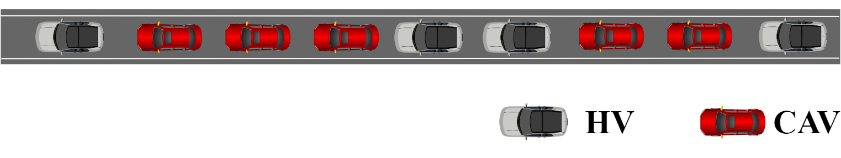
Introduction
Preliminary
API
Flow Estimation
Conclusion
Model Assumptions
The research focuses on the longitudinal behaviour of vehicles on the single-lane road. Therefore, the lateral vehicle actions, e.g., lane-changing and merging, are not considered.
The study concentrates on mixed traffic, which only includes connected and autonomous vehicles (CAVs) and human-driven vehicles (HVs). Pure CAVs or HVs on the road could be considered as special cases.
Notes:
To propose a more accurate and effective measurement of CAV clustering strength, we begin by modeling the mixed traffic under the following assumptions. This research focuses solely on the longitudinal behavior of vehicles on a single-lane road, excluding lateral actions such as lane-changing and merging. The study concentrates on mixed traffic comprising CAVs and HVs. Scenarios with only CAVs or only HVs are considered special cases within this framework.

Slide 9
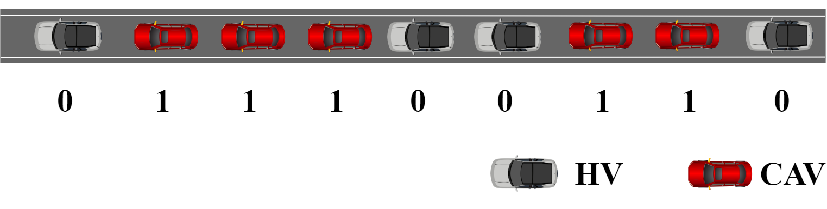
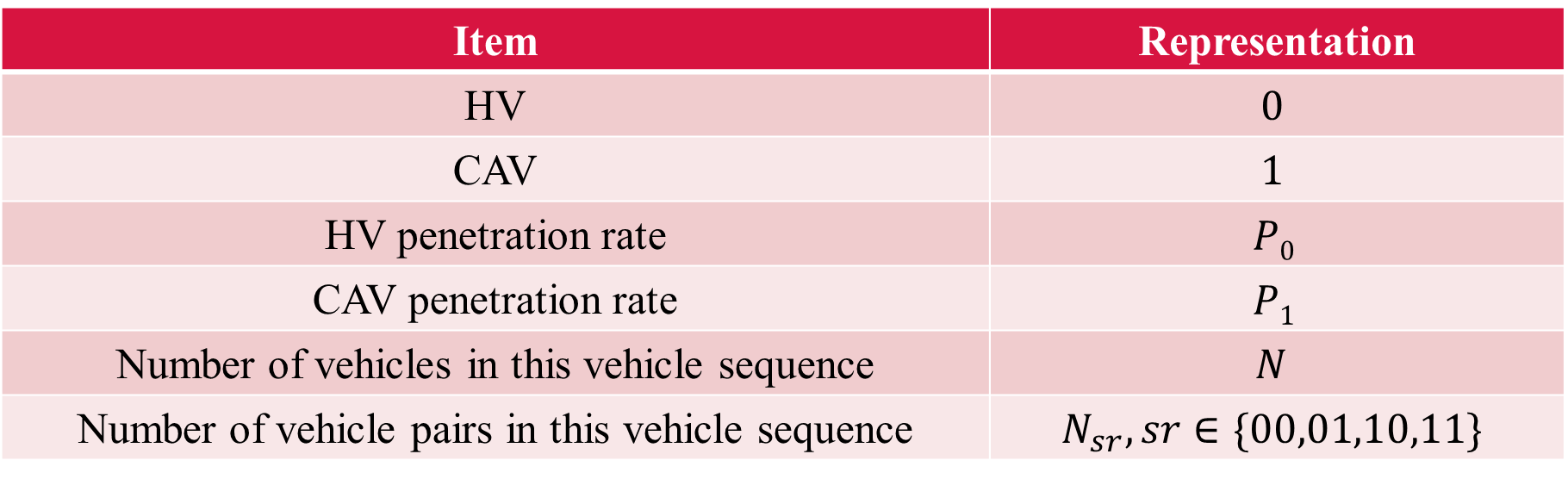
Introduction
Preliminary
API
Flow Estimation
Conclusion
Modeling the Mixed Traffic
Item | Representation
HV | $$0$$
CAV | $$1$$
HV penetration rate | $$P0$$
CAV penetration rate | $$P1$$
Number of vehicles in this vehicle sequence | $$N$$
Number of vehicle pairs in this vehicle sequence | $$N_{sr}, sr∈\{00,01,10,11\}$$
Notes:
Next, we use the digital representation of 0 and 1 to denote HVs and CAVs, respectively, on this single-lane road. P0 and P1 refer to the penetration rates of HVs and CAVs. N represents the total number of vehicles in this sequence, while Nsr indicates the number of vehicle pairs.

Slide 10
Introduction
Preliminary
API
Flow Estimation
Conclusion
Autocorrelation-based Platooning Intensity (API)
Definition
Similarity in vehicle types between two consecutive vehicles within a vehicle sequence.
Calculation
Sequence Autocorrelation Function (ACF), ranging between -1 and 1, measures the relationship between a variable’s present value and its lagged values. Applied in mixed Traffic, it can also reflect the relationship between 2 consecutive vehicles.
Notes:
Based on the proposed mixed traffic model and related assumptions, we introduce a new definition of platooning intensity: the similarity in vehicle types between two consecutive vehicles within a sequence. For instance, if the leading vehicle is an HV and the follower is a CAV, their types differ. Conversely, if both the leader and follower are CAVs, their types are the same. To capture this similarity, we employ the sequence autocorrelation function (ACF). The ACF, ranging strictly between -1 and 1, measures the relationship between a variable's present value and its lagged values. When applied to mixed traffic, it effectively reflects the relationship between two consecutive vehicles, indicating the similarity in vehicle types.

Slide 11
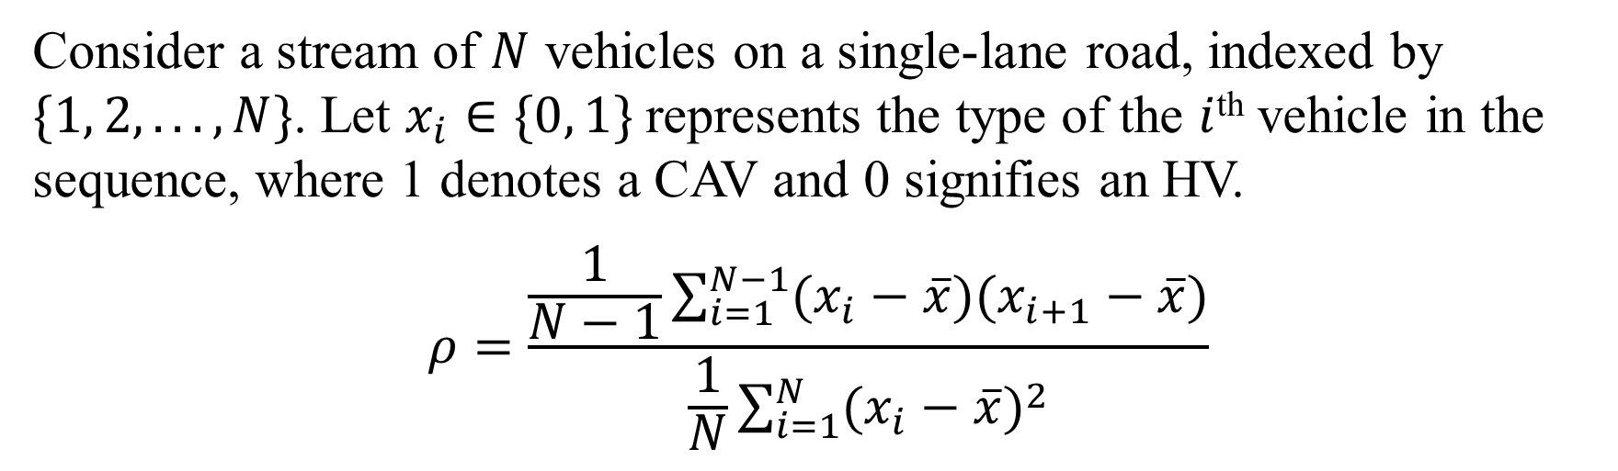
Introduction
Preliminary
API
Flow Estimation
Conclusion
Autocorrelation-based Platooning Intensity (API)
Consider a stream of $N$ vehicles on a single-lane road, indexed by $\{1, 2, . . . ,N\}$. Let $x_{i}∈\{0, 1\}$represents the type of the $i$^{th} vehicle in the sequence, where 1 denotes a CAV and 0 signifies an HV.
$$ρ=\frac{\frac{1}{N−1}\sum_{i=1}^{N−1}{(x_{i}−\overline{x})(x_{i+1}−\overline{x})}}{\frac{1}{N}\sum_{i=1}^{N}{{(x_{i}−\overline{x})}^{2}}}$$
Notes:
Specifically, consider a sequence of N vehicles on a single-lane road, indexed from 1 to N in order. Let x_i represent the type of the i-th vehicle, either CAV or HV. The API can then be calculated using the following equations.

Slide 12
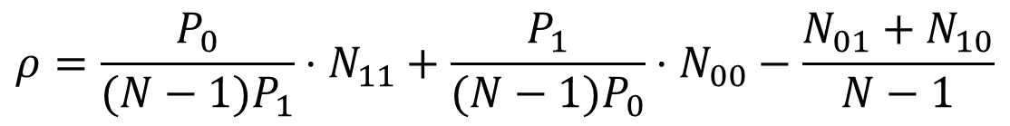
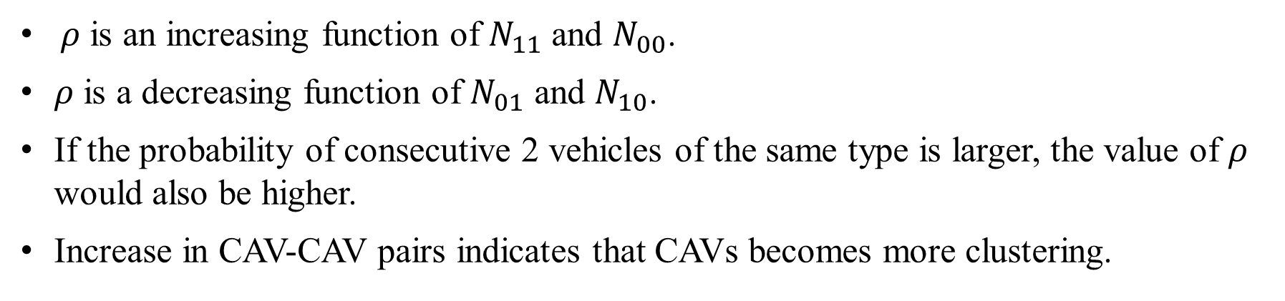
Introduction
Preliminary
API
Flow Estimation
Conclusion
API can effectively quantify the degree of CAV platoon clustering
$$ρ=\frac{P_{0}}{(N−1)P_{1}}⋅N_{11}+\frac{P_{1}}{(N−1)P_{0}}⋅N_{00}−\frac{N_{01}+N_{10}}{N−1}$$
$ρ$ is an increasing function of $N_{11}$ and $N_{00}$.
$ρ$ is a decreasing function of $N_{01}$ and $N_{10}$.
If the probability of consecutive 2 vehicles of the same type is larger, the value of $ρ$ would also be higher.
Increase in CAV-CAV pairs indicates that CAVs becomes more clustering.
Notes:
Then, by incorporating vehicle pairs, Nsr, API can be further developed as shown in this equation. We find that API increases with $N_{11}$ and $N_{00}$, and decreases with $N_{01}$ and $N_{10}$​. Hence, if the probability of two consecutive vehicles being of the same type is higher, the API will also be higher. In terms of clustering strength, an increase in CAV-CAV pairs indicates that CAVs are becoming more clustered.

Slide 13
Introduction
Preliminary
API
Flow Estimation
Conclusion
Features of API
Existing PIs | API
Derived from infinite vehicles | Suitable for any number of vehicles
May be out of bound for finite vehicles | Based on ACF, API is strictly ranging from -1 to 1
Unlimited range
Restricted ability capturing CAV spatial distribution when the number of CAVs forming the platoons is fixed but the size of a platoon is random. | Rather than focusing on platoons, API is based on vehicle pairs which can effectively quantify the clustering strength as demonstrated before.
Notes:
We have explained the definitions, calculations and equtions of API, and demenotrate that API could effectively quantify the clustering strength from the perspective of vehicle pairs. Here we briefly list the features of API compared with the existing definitions of platooning intensity. As some PIs apply to the infinite vehicles, our API fits for vehicle sequence with any number of vehicles. Based on Sequence ACF, API is strictly ranging from -1 to 1. Meanwhile, from the perspective of vehicle pairs, API can more effectively capture the level of CAV clustering compared to the existing PIs. Moreover, the detailed comparison between the proposed API and other platooning intensities is described in our paper through mathematical derivation and case analysis, so we will omit the comparison here.

Slide 14
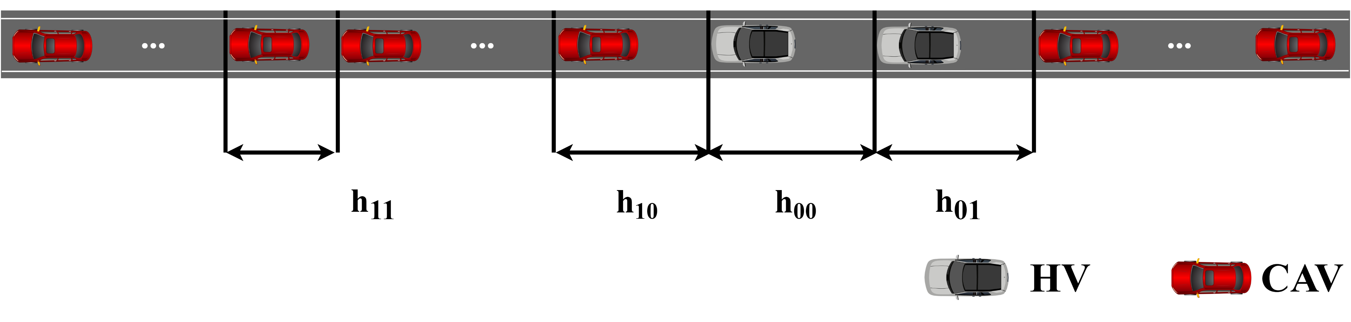
Introduction
Preliminary
API
Flow Estimation
Conclusion
Modelling Traffic Capacity
Reciprocal of Average headway
(This Study）
Traffic Flow Calculation
Relationship among flow, density and speed, i.e., fundamental Diagram
Notes:
Using this superior indicator, API, we model mixed traffic capacity and analyze how API influences it. To model traffic capacity, there are two common methods: one is taking the reciprocal of average headway, and the other is based on the relationship from the fundamental diagram. In this study, we adopt the first method. Then, identifying the headway types is crucial because the headway between CAVs and HVs is often different due to varying vehicle behavior. With two types of vehicles, there are four types of headways. Specifically, h11​ denotes the headway between two consecutive CAVs, and h00​ denotes the headway between two consecutive HVs. If the leader is a CAV and the follower is an HV, we use h10​; and if the leader is an HV and the follower is a CAV, we use h01​.

Slide 15
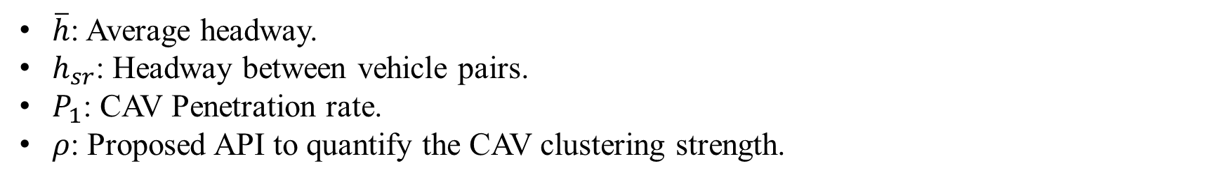
Introduction
Preliminary
API
Flow Estimation
Conclusion
Modeling Traffic Capacity
$$\hat{q}=\frac{1}{\overline{h}}=\frac{1}{\left(1−P_{1}\right)\left(ρP_{1}+1−P_{1}\right)h_{00}+P_{1}\left(1−P_{1}\right)\left(1−ρ\right)\left(h_{01}+h_{10}\right)+P_{1}[ρ\left(1−P_{1}\right)+P_{1}]h_{11}}$$
$\overline{h}$: Average headway.
$h_{sr}$: Headway between vehicle pairs.
$P_{1}$: CAV Penetration rate.
$ρ$: Proposed API to quantify the CAV clustering strength.
Notes:
Then, mixed traffic capacity can be estimated as this equation, and we omit the detailed derivation process here. In this approximation model, headway, CAV penetration rate, and clustering strength are treated as key influencing factors on traffic capacity.

Slide 16
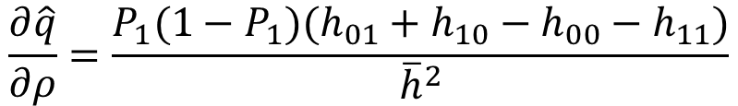
Introduction
Preliminary
API
Flow Estimation
Conclusion
Impact of CAV Clustering Strength on Traffic Capacity
$$\hat{q}=\frac{1}{\overline{h}}=\frac{1}{\left(1−P_{1}\right)\left(ρP_{1}+1−P_{1}\right)h_{00}+P_{1}\left(1−P_{1}\right)\left(1−ρ\right)\left(h_{01}+h_{10}\right)+P_{1}[ρ\left(1−P_{1}\right)+P_{1}]h_{11}}$$
$\overline{h}$: Average headway.
$h_{sr}$: Headway between vehicle pairs.
$P_{1}$: CAV Penetration rate.
$ρ$: Proposed API to quantify the CAV clustering strength.
$$\frac{∂\hat{q}}{∂ρ}=\frac{P_{1}(1−P_{1})(h_{01}+h_{10}−h_{00}−h_{11})}{{\overline{h}}^{2}}$$
Capacity is an increasing function of platooning intensity when $h01 + h10 > h00 + h11$
Capacity is a decreasing function of platooning intensity when $h01 + h10< h00 + h11$
Notes:
And to analyze the impact of CAV clustering strength on traffic capacity, we take the partial derivative of capacity with respect to clustering strength. Then, Capacity is an increasing function of platooning intensity when $h01 + h10 > h00 + h11$ because the partial derivative is larger than 0; and capacity is a decreasing function of platooning intensity when $h01 + h10< h00 + h11$.

Slide 17
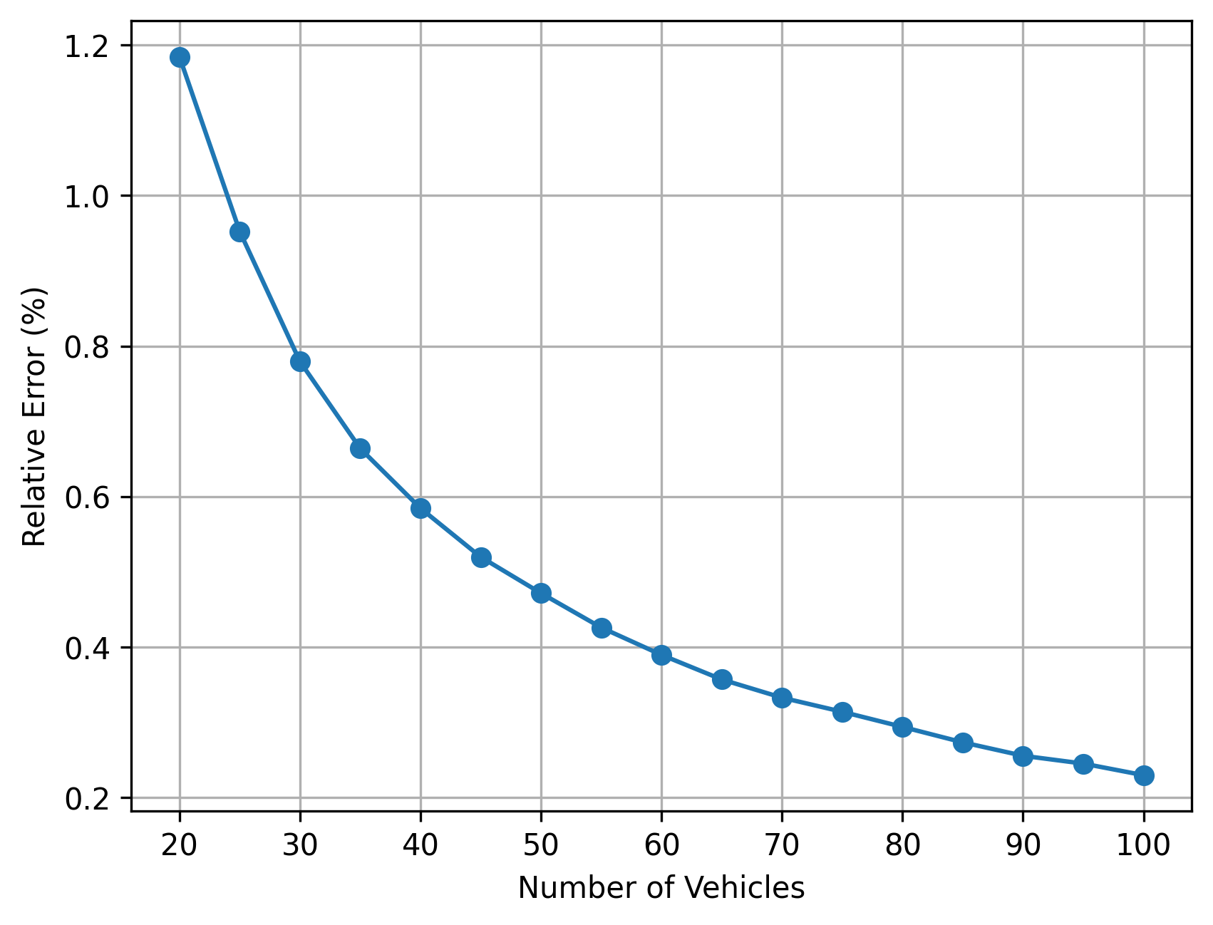
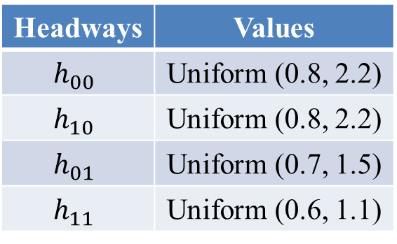
Introduction
Preliminary
API
Flow Estimation
Conclusion
Accuracy of Capacity Approximation
Estimated Capacity: $\hat{q}=\frac{1}{\overline{h}}=\frac{1}{\left(1−P_{1}\right)\left(ρP_{1}+1−P_{1}\right)h_{00}+P_{1}\left(1−P_{1}\right)\left(1−ρ\right)\left(h_{01}+h_{10}\right)+P_{1}[ρ\left(1−P_{1}\right)+P_{1}]h_{11}}$
Theoretical Capacity : $q=\frac{1}{\overline{h}}=\frac{N−1}{N_{00}h_{00}+{N_{01}h}_{01}+{N_{10}h}_{10}+N_{11}h_{11}}$
Relative Error: $ε=\frac{|q−\hat{q}|}{q}$
Headways | Values
$$h_{00}$$ | Uniform (0.8, 2.2)
$$h_{10}$$ | Uniform (0.8, 2.2)
$$h_{01}$$ | Uniform (0.7, 1.5)
$$h_{11}$$ | Uniform (0.6, 1.1)
Notes:
Beyond the theoretical modeling of traffic capacity, we conduct a series of numerical experiments to demonstrate the accuracy of our approximations and verify the aforementioned propositions. According to traffic flow theory, the theoretical capacity can be calculated as a weighted average of different types of headway. We then use the relative error between the estimated and theoretical capacity to measure the accuracy of our approximation.
Given a specific number of vehicles N, there are a total of 2^N combinations of CAVs and HVs. We randomly select 10,000 combinations. For each combination, we compute the estimated capacity, theoretical capacity, and the relative error. The headway values used in these equations are shown here. Our results indicate that the relative error is less than 1% when the number of vehicles on a single lane exceeds 30, demonstrating the high accuracy of our model.

Slide 18
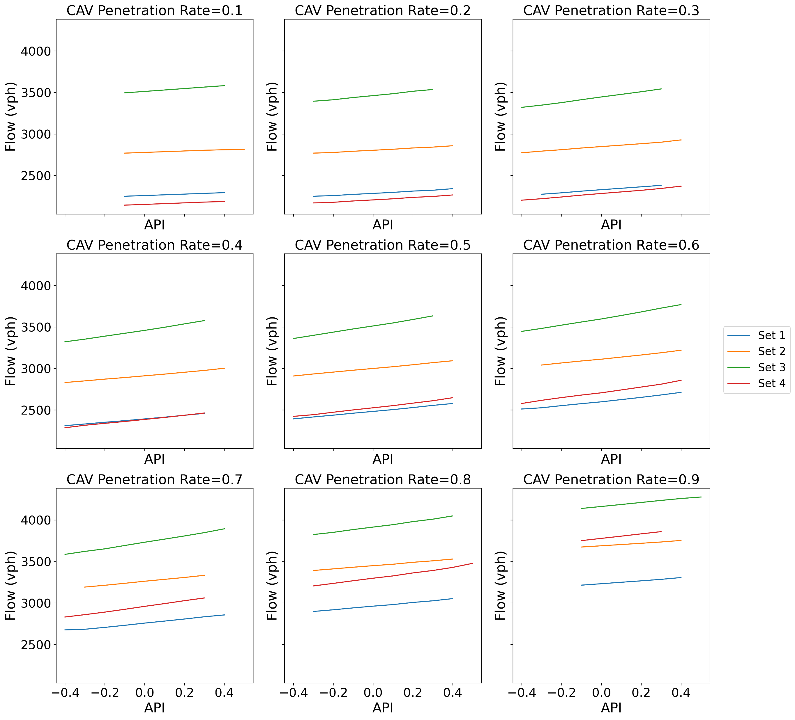
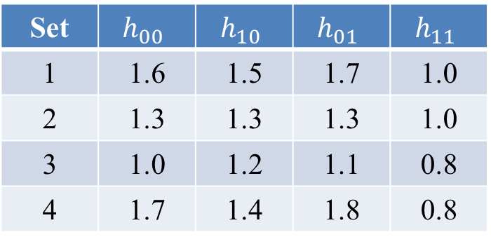
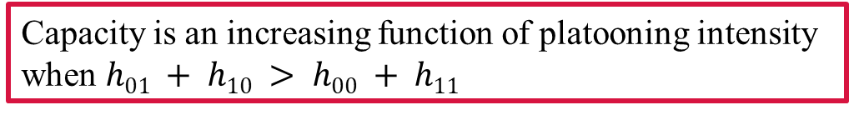
Introduction
Preliminary
API
Flow Estimation
Conclusion
Verification of Proposition 1
Capacity is an increasing function of platooning intensity when $h01 + h10 > h00 + h11$
Set | $$h_{00}$$ | $$h_{10}$$ | $$h_{01}$$ | $$h_{11}$$
1 | 1.6 | 1.5 | 1.7 | 1.0
2 | 1.3 | 1.3 | 1.3 | 1.0
3 | 1.0 | 1.2 | 1.1 | 0.8
4 | 1.7 | 1.4 | 1.8 | 0.8
Notes:
We conducted a numerical verification using 100 vehicles, selecting various headway values to fit the conditions of the propositions. We set the CAV penetration rate to range from 0.1 to 0.9, generating 10,000 sequences under each penetration rate. These sequences were subsequently grouped according to their API, and the average capacity for each group was calculated. As shown in this figure, the mixed traffic capacity increases with the rise of API, which aligns with Proposition 1.

Slide 19
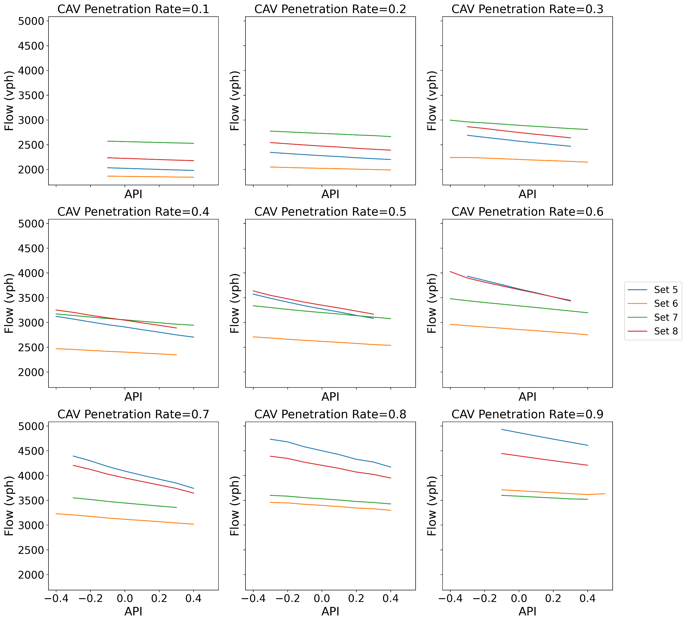
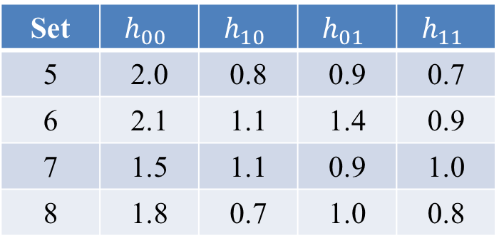

Introduction
Preliminary
API
Flow Estimation
Conclusion
Verification of Proposition 2
Capacity is a decreasing function of platooning intensity when $h01 + h10< h00 + h11$
Set | $$h_{00}$$ | $$h_{10}$$ | $$h_{01}$$ | $$h_{11}$$
5 | 2.0 | 0.8 | 0.9 | 0.7
6 | 2.1 | 1.1 | 1.4 | 0.9
7 | 1.5 | 1.1 | 0.9 | 1.0
8 | 1.8 | 0.7 | 1.0 | 0.8
Notes:
Similarly, numerical experiments reveal that under the conditions of Proposition 2, an increase in API results in a reduction in mixed traffic capacity.

Slide 20
Introduction
Preliminary
API
Flow Estimation
Conclusion
Conclusions
The employment of auto-correlation function in mixed traffic, as the platooning intensity, can effectively quantify the degree of CAV clustering.
A framework is formulated to estimate the traffic capacity considering CAV penetration rate, platooning intensity, and headway, which has a small error with theoretical traffic capacity.
Marginal analysis shows that the mixed traffic capacity does not consistently exhibit an increasing or decreasing trend with respect to platooning intensity under the influence of headway stochasticity, which can be used as a supplement to the existing research.
Notes:
Based on this findings, we draw the following conclusions:
Firstly, the use of the autocorrelation function as a measure of platooning intensity in mixed traffic effectively quantifies the degree of CAV clustering.
Secondly, we have formulated a framework to estimate traffic capacity, taking into account CAV penetration rate, platooning intensity, and headway. This framework demonstrates a small error compared to the theoretical traffic capacity.
Lastly, marginal analysis reveals that mixed traffic capacity does not consistently show an increasing or decreasing trend with respect to platooning intensity due to headway variability. This finding complements existing research.

Slide 21
Introduction
Preliminary
API
Flow Estimation
Conclusion
Contributions
Theoretical contributions:
A novel and superior definition of platooning intensity to quantify the clustering strength.
A framework to evaluate mixed traffic capacity is formulated.
Application contributions:
Under the influence of headway, it is revealed that clustering more CAVs together may not necessarily enhance traffic capacity.
To improve traffic capacity, the sum of heterogeneous headways should be larger than the homogeneous headways.
This insight provides valuable guidance for mixed traffic management and headway design.
Notes:
Then, the theoretical contributions of our work include the proposal of a novel and superior definition of platooning intensity to quantify clustering strength, as well as a framework to evaluate mixed traffic capacity based on the proposed API.
Additionally, the practical contributions of our study challenge the common assumption that clustering more CAVs together necessarily enhances traffic capacity. Our findings suggest that to improve traffic capacity, the sum of heterogeneous headways should be larger than the homogeneous headways. This insight offers valuable guidance for mixed traffic management and headway design.

Slide 22

Thank you
Welcome the feedback to make us work better.
Zhao Peilin
Peilin001@e.ntu.edu.sg

